Slide 1

ASVAB Career Exploration Program
September 2019

Slide 2
Agenda
CEP Metrics
CEP IPR (Accession Policy, MEPCOM , and OPA)
Needs Assessment and Recommendations
State Usage of ASVAB CEP
PTI Proficiency Training
FYI Revisions
Option Ready

Slide 3
ASVAB CEP Metrics

Slide 4
ASVAB CEP Numbers and Metrics
Year* | Number of Students Tested
2013 | 670,836
2014 | 690,950
2015 | 687,900
2016 | 706,200
2017 | 684,223
2018 | 713,777
2019 | 786,807
Year* | Number of Schools Tested | Percentage of Schools Tested
2013 | 12,613 | 56%
2014 | 12,731 | 56.4%
2015 | 12,929 | 56.6%
2016 | 13,169 | 57.2%
2017 | 12,870 | 55.5%
2018 | 12,380 | 55%
2019 | 13,976 | 60.6%
*School year runs from July 1- June 30. Data as of 30 June of respective year.

Slide 5
School Year 18-19
Paper and Pencil Numbers
CEP iCAT Numbers
 | Examinees 17-18 | Examinees 18-19
TOTAL | 662,564 | 714,442
 | Examinees 17-18 | Examinees 18-19
TOTAL | 51,213 | 72,474
*Total students as of 30 June each year.
Notes:
The number of P&P + CEP iCAT should = Total Students Tested?
(714,442 + 72,474 = 786,916; Total student is 786,807)?? Diff of 109
In a perfect world those two numbers should equal the total tested, however those numbers were pulled on different days July 12th (total tested) August 5th (CEP/PnP). The MEPS were able to process tests after July 12th because the MEPS IT personnel can go into the system and change the school year so that's more than likely the reason the numbers are off.

Slide 6
Leads and Options
Year* | Leads Provided to Military Services
2014 | 492,419
2015 | 470,229
2016 | 478,196
2017 | 440,542
2018 | 433,317
2019 | 468,003
Option | Results to Recruiting Services
1 | 7 days after test scores are mailed
2 | 60 days after test scores are mailed. No contact prior to that time.
3 | 90 days after test scores are mailed. No contact prior to that time.
4 | 120 days after test scores are mailed. No contact prior to that time.
5 | End of school year. No contact prior to that time.
6 | 7 days after test scores are mailed. No telephone solicitations by recruiters.
7 | Administrative option used by USMEPCOM ONLY for test administration issues for individual or group tests (test abandoned, cheating, insufficient proctors, fire drills, etc.). Not valid for enlistment purposes. Results not released to Recruiting Services.
8 | Not released to Recruiting Services *While student results are not released to military services, scores are valid for enlistment for two years after test date.
Total students as of 30 June each year.

Slide 7
Accessions By Service:
Number of Students Using ASVAB CEP Score for Enlistment
Year* | ARMY | NAVY | AIR FORCE | MARINE CORPS | COAST GUARD | TOTAL
2014 | 14,513 | 4,439 | 3,677 | 5,474 | 130 | 28,233
2015 | 15,156 | 4,731 | 3,669 | 5,682 | 285 | 29,523
2016 | 14,449 | 4,990 | 4,121 | 5,655 | 310 | 29,525
2017 | 15,053 | 4,310 | 4,465 | 6,037 | 392 | 30,257
2018 | 14,432 | 4,699 | 4,234 | 5,370 | 405 | 29,140
2019 | 13,430 | 4,963 | 4,700 | 5,163 | 358 | 28,614
*School year runs from July 1- June 30.

Slide 8
CEP IPR

Slide 9
Preliminary Recommendations for Elimination of P&P
COA 1: DPAC develop an access code process valid for a specific period of time or test window, similarly to current Single Site Testing procedures. A school would be provided the code to access the CEP iCAT and be able to test their students on their schedule based on the availability of their computer lab(s) within the assigned test window. The schools would be able to test without a MEPS TA/ITA present.
DRAWBACK: Increased test administration support required from school personnel
COA 2: USMEPCOM purchase tablet computers for each MEPS to make available to test administrators when needed for use at a school. A suitable number of tablets would be determined and issued to each MEPS. When a school desired to test and did not have the right equipment to test, or no computers at all, the tablet computers would be issued to a TA in order to conduct the test. This would require a version of the CEP iCAT compatible with tablets. DPAC would need to develop alternate interfaces and a new test delivery application to run on tablets of interest. DPAC would need to conduct a study to evaluate whether there are any psychometric issues such as performance differences across the different tablets. This work is underway at DPAC and projected for completion in Sept 2019.
DRAWBACK: Increased costs associated with the purchase and maintenance of tablets and associated security and test delivery software.
COA 3: USMEPCOM purchase and configure a government laptop as a server or hotspot to provide the test via local network or wifi to school tablets and or student phones, by developing a CEP “app” that the student could take the CEP on their phone in the school setting. This would require programming and test development by both USMEPCOM and DPAC. DPAC would have to be consulted regarding feasibility as well as the time and effort required to complete the programming and new test versions. Additionally, DPAC would need to conduct a study to evaluate whether there are any psychometric issues with this option.
DRAWBACK: Increased costs associated with developing an iCAT application that runs on existing student/school devices
COA 4: Administer the P&P CEP test as a “low stakes” test where applicants would take a verification test at the MEPS if the results are used for enlistment. This would allow continued use of the P&P test. DPAC would need to develop a verification test process similar to that used for PiCAT, so DPAC would need to determine feasibility and level of effort. This option would require MAPWG approval prior to conducting any level of effort analysis.
DRAWBACK: Discontinued use of CEP P&P ASVAB scores for operational enlistment purposes (negatively impact accessions)
COA 5: Develop a test version which could be administered via DVD. This would allow a MEPS to send an appropriate number of disks to a school to have them plug the disk into their computers and administer the test. This option would require DPAC programming to administer the test via a disk. DPAC would have to be consulted regarding feasibility as well as the time and effort required to complete the programming. DPAC would need to conduct a study to evaluate whether there are any psychometric issues with this option.
DRAWBACK: Security and cost implications of developing a stand-alone (non-internet) version of CAT-ASVAB for use in CEP.

Slide 10
Conclusions and Next Steps:
P&P-ASVAB testing should continue in the CEP for schools that lack sufficient infrastructure (i.e., computers and internet connectivity)
Backup P&P forms should be identified for use in the CEP in the event of a compromise
  Identify form/s from P&P – ASVAB 20 – 22 series
  Tiger Team with DPAC, MEPCOM, and AP to develop PO&AM for implementation
Where possible, steps should be taken to increase utilization of iCAT
  DPAC has identified DMDC team leads to address monitoring issues
  DMDC assigned POCs to resolve connectivity issues
  Requested RAM increase
  Requested serves increase
  DPAC continues to work with DMDC to create systematic plan to accommodate approximately 2 million additional users (transition of WinCAT and CEP P&P to iCAT).
  Ultimate transition from iCAT to Cloud
Conducting Device Evaluation Study

Slide 11
Conclusions and Next Steps:
Allow iCAT administration using 12” monitors
Expand iCAT browser options to Safari
  DPAC developing implementation timeline
Continue to work with CAVEON to identify potentially compromised material
  The largest online arena of potential ASVAB threats was from free and for profit test prep sites
  Other areas where reported potential threats occurred were Video Archives, Flashcard Sites, Social Media, Mobile Apps, Document Archives and Brain dump Sites.
  Provide additional test item content to CAVEON for review

Slide 12
Needs Assessment and Action Items

Slide 13
Expert Panel/Needs Assessment: Recommendations and Progress
Program Processes:
Develop electronic reminder system to maintain contact with students and parents between testing and interpretation.
Develop a mechanism for including parents in the career exploration process.
Develop a protocol for sending personalized reminders of available resources and activities that can further engage the students in reflecting on their assessment results and career/educational exploration plans.
Session numbers and other manual processes hindering effectiveness of program (Needs Assessment Finding)
  Business Modernization Contract
    Includes a look at manual processes that occur throughout the lifecycle of the CEP, from scheduling to accountability. Includes requirements gathering to update legacy systems. Joint project with USMEPCOM. June 2019-2020

Slide 14
Expert Panel/Needs Assessment: Recommendations and Progress
Assessments:
Expert panel recommended a review/evaluation of the current FYI item pool to achieve an inventory that encompasses critical, occupationally relevant tasks for high school students and is culturally appropriate
  FYI Revision Efforts
    Presentation by Olga Friedman to follow on current state of FYI. Future efforts will commence September 2019-2021

Slide 15
Expert Panel/Needs Assessment: Recommendations and Progress
Websites:
Under Resources, some are .pdf files and some are Word documents. The panel recommends converting all resources into writeable .pdf files. The website also should provide a link to Adobe for those who might not have downloaded the software to read pdfs.
The Resources section also contains links to items that are not relevant to students (i.e., ASVAB CEP Counselor Guide). The panel recommends that the website is configured such that the available resources are specific to each user population (students, educators, parents).
  Reconfigured and implemented a new resource center on asvabprogram.com, includes integration of twitter feed and other social media.
  Website reconfiguration planned with website refresh (2021-2022)

Slide 16
Expert Panel/Needs Assessment: Recommendations and Progress
Marketing
The ASVAB CEP and the FYI should be marketed to professional journals and textbooks, as well as integrated into the National Certified Counselors curriculum.
  ASVAB CEP included in: A comprehensive Guide to Career Assessment, 7th Edition, Published by NCDA
  https://www.ncda.org/aws/NCDA/pt/sd/product/11018/_PARENT/layout_products/false
Part IV – Career Assessment Instrument Reviews
Ability Explorer – Kathy M. Evans (Both Print and Online)
Ashland Interest Inventory – Darrin L. Carr, Pamela McCoy, & Alyssa West
ASVAB – Laith G. Mazahreh
California Psychological Inventory – Rebekah Reysen
Career Decision Self- Efficacy Scale – Joshua C. Watson (Both Print and Online)
Career Occupational Preferences System Interest Inventory (COPS) – Jenna Crabb
Career Thoughts Inventory – Brian M. Calhoun
Jackson Career Explorer – Justin R. Fields
Jackson Vocational Interest Inventory – Julie Aitken Schermer
Kuder Career Planning System – Melinda M. Gibbons & Charmayne R. Adams (Both Print and Online)
NEO-4 – Brian J. Taber
Occupational Aptitude Survey and Interest Schedule (OASIS-3) – Amanda G. Flora
Self- Directed Search – Chad Luke & Zach Budesa
Work Values Inventory – S. Autumn Collins
Career Construction Interview – Louis A. Busacca (Both Print and Online)
Career Genogram – Tina M. Anctil
Knowdell Card Sorts – Tanya M. Campos

Slide 17
Expert Panel/Needs Assessment: Recommendations and Progress
Reports and Interpretation
Post Test Interpretations, inconsistencies, lack of website usage (Needs Assessment)
Identify strategies to increase engagement with the CEP to increase the amount of time spent exploring occupational information and other resources to strengthen the depth of processing and personal relevance. For example, involve more interactive online activities, and link to the portfolio within the CITM with internet resources and activities that supplement guided exploration with counselors and parents.
  PTI Training Effort
    Detailed information on the virtual and in-person training to follow. February 2019-August 2019 (As needed)

Slide 18
Expert Panel/Needs Assessment: Recommendations and Progress
Identify strategies to increase engagement with the CEP to increase the amount of time spent exploring occupational information and other resources to strengthen the depth of processing and personal relevance.
Conduct a thorough review of training provided to Education Services Specialists and of post-test interpretation processes, to include updates to the websites, measures, and activities.
Expand the interpretative information for ASVAB results to provide detailed suggestions for understanding and strengthening skills. Consider including additional reflective questions to enhance understanding of results and facilitate action steps for the career exploration process.
Make it a priority to increase the number of computerized administration options beyond the current CEP, including smartphone applications.
  Classroom activity inclusion and PTI Training
    By educating the field on the information included in the websites, and inviting recruiting commands to participate in the train-the-trainer model, we have built in multiple opportunities for schools, counselors, and recruiters to use the CEP to inform students of their options. (Ongoing)

Slide 19
Expert Panel/Needs Assessment: Recommendations and Progress
Other Comments, Suggestions, Ideas for the Program:
Develop a work values measure that links an individual’s work values to occupations
  Under contract September 2019-2020
Develop a Successful Job Search toolbox on the asvabprogram.com website that includes how to develop a resume, use social media, search for a job, and interview for a job
  Under contract June 2020
Provide uniform credentialed career development training to ASVAB CEP administrators and interpreters
  USMEPCOM investigating funding options and feasibility of incorporation in the CP-31 Program.
  Investigating offering CEUs for pre-conference workshops

Slide 20
Actions Completed:
  Reviewed past reports on pilot efforts to incorporate iCAT into the CEP and observation forms provided by test administrators
  Conducted observations of current paper-and-pencil and CEP iCAT sessions
  Obtained input from DPAC and MEPCOM personnel, ESS, and others in the field on the status of iCAT CEP
  Made recommendations for improving the current situation and provide alternative business models for iCAT CEP

Slide 21
Recommendations:
Paper-and-Pencil and iCAT Administrations
  Reinforce rules related to proper proctor behavior
  Institute a database management system to issue session numbers
Paper-and-Pencil ASVAB Administrations
  Done in accordance with recommended procedures
  Review instructions with the aim of making them more succinct, eliminate repetition

Slide 22
Recommendations, cont:
iCAT Administrations
  Eliminate data fields in test that are not routinely completed by students (e.g., address, avowal of physical fitness)
  Identify method to circumvent issues with students needing to reenter information exactly as first entered when there is a need to log-in a second time
  Standardize log-in procedures
  Streamline log-in procedures for test administrators
  Allow TAs to reset passwords rather than having to call Help Desk
  Address bandwidth issues
    Stress the requirement that school IT personnel be consulted during scheduling to ensure sufficient bandwidth and minimal conflicts
  Stress administration protocols
  Ensure that Help Desk support is available during testing and that server maintenance doesn’t occur during testing
  Institute a nationwide scheduling system so Help Desk and IT personnel know when testing is occurring and where
  Expand browsers through which iCAT can be accessed
  Address issues regarding screen resolution

Slide 23
Recommendations, cont:
Score reporting
  Investigate possibility of allowing ESS to access score reports with user name and password vs CAC
    Opens up possibility of same-day testing and interpretation
    Same-day PTIs would reduce ESS scheduling and travel burden
  Address issues reported by ESS with printing score reports
Post-Test Interpretations (PTI)
  Standardize PTIs – will ensure students receive the most relevant and accurate information
  Focus on score reports, using ASVAB and FYI scores to explore careers, and accessing information in the future
  Employ registration feature that ties student’s email to their access code, so only email and password are needed to access sites
  Include PTIs in performance metrics of MEPS/ESS, rather than just number of students tested
  Consider alternate methods of providing PTIs
    Train school personnel (e.g., counselors, teachers)
    Develop online, interactive modules to guide students through the process

Slide 24
State Usage of ASVAB CEP

Slide 25
ASVAB CEP and ESSA
Several States have passed legislation requiring schools to provide ASVAB CEP to high school students
Military Services have been speaking to legislators about the ASVAB CEP and the benefits of the program.
Meeting to include participants from AP, USMEPCOM, Military Service Liaisons, and Recruiting Commands.
Stakeholder meeting August 15 in Alexandria, VA
Agenda: Review of States and how they use ASVAB CEP, Service initiatives, review of legislative calendar, AP guidance, data and processes for obtaining data, social media and tool kits

Slide 26
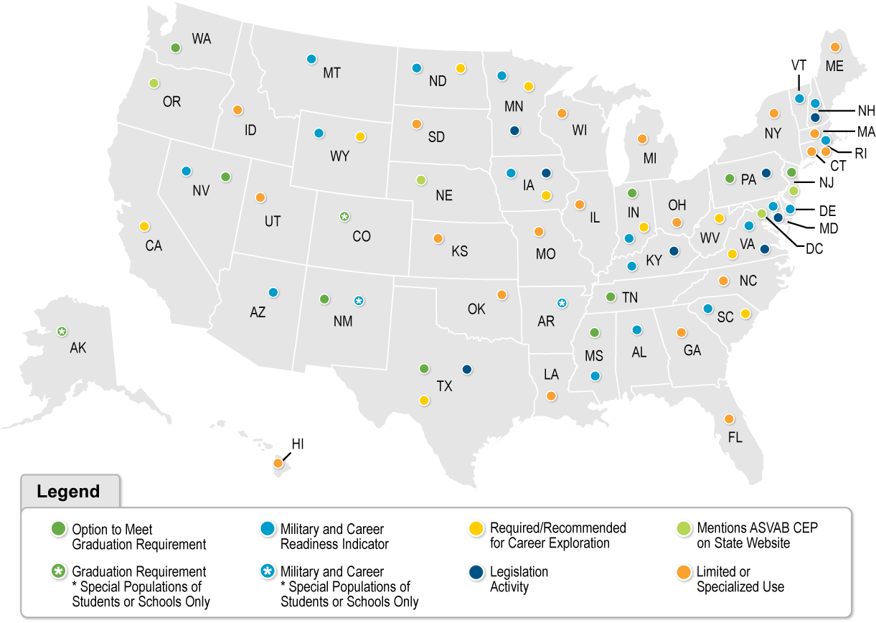
Level of Engagement by State

Slide 27
ESS and Recruiting Commands Engagement with State BOEs
Supplied a memo to the field regarding the appropriate uses of the ASVAB CEP (Approved by AP)
Included guidance during State presentations, Q/A sessions, National Conferences on appropriate uses of ASVAB CEP
Will continue to monitor State legislation and utilization of ASVAB CEP

Slide 28
Contracting Effort: State Usage of ASVAB
Monitoring websites
  State Boards and Departments of Education
Goal: Glean any mention of their use of ASVAB or CEP
Method
  Excel file with links to each state’s Board or Department of Education news/press release website, dummy variable tracking if state websites offer any information on ASVAB CEP
  Websites checked weekly for any updates/changes
  Offer notes on ESSA and other career exploration information from the state

Slide 29


ASVAB CEP Orientation Event in Indiana
ASVAB CEP is included as a Pathway to Graduation in Indiana
  IDOE hosted a three-hour overview of program components
  125 attendees
    Most were previously unaware of the website offerings
    70% said they will utilize the PTI in the future
  Opportunity for follow up webinar series
    How planning tools map to pathways

Slide 30
PTI Proficiency Training

Slide 31
PTI Proficiency Training
Because:
We have more States looking at the ASVAB CEP as a program to give for career exploration, we have an increased pressure to visit schools more than once (additional work load), and deliver a standard program. (Needs Assessment, Expert Panel Recommendation)
Because we have added so much new functionality to asvabprogram.com and careersinthemilitary.com, MEPS ESSs (as a whole) have not been adequately trained to use the websites effectively or to train others to use them. (Needs Assessment, Expert Panel Recommendation)
We have not had a way to track our national work force for ASVAB CEP in delivering PTIs. With the introduction of virtual training, a standard metric, and training, we can now establish this. (DAC Recommendation)
This training will be a stepping stone to the Certified Career Counselor Credential offered by the National Career Development Association. (Needs Assessment, Expert Panel Recommendation, DAC Recommendation)
The standard metric of required elements, with behavioral anchors, removes most subjectivity of the training process, and allows us to use it as a learning and evaluation tool. (Expert Panel Recommendation)

Slide 32
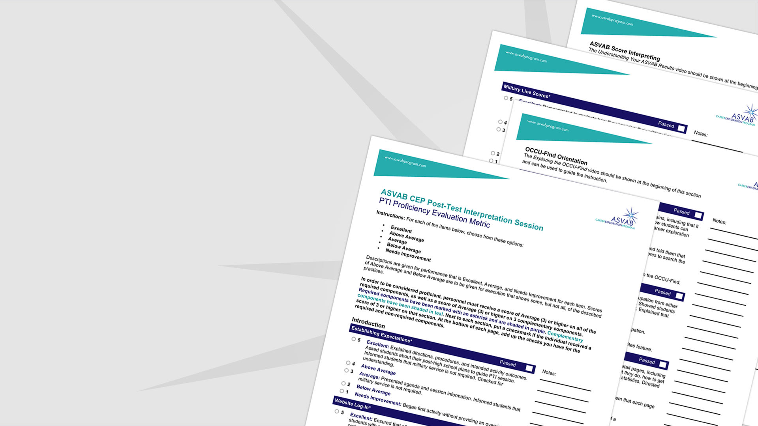
PTI Proficiency Requirements
Be Nominated to Become Proficient
Complete Virtual Training Modules
Be Observed Effectively Conducting a PTI
Load Proof of Proficiency into Moodle

Slide 33
Post-Test Interpretation Proficiency Training
In-Person PTI Training
Participation
USMEPCOM | 141
Army | 88
Navy | 17
Air Force | 8
Coast Guard | 10
Goal: Standardize the process by which post-test interpretation (PTI) sessions are conducted. Serve as a workforce multiplier (using a train the trainer approach) by including Recruiting Service Partners to satisfy demand for program in schools.
Purpose: Address expert panel recommendations to orient attendees to the ASVAB CEP enhancements, and teach attendees the strategic purposes of collaborating with others operating within their territory to achieve missions.
Metrics to Gauge Success: Increased utilization of ASVAB CEP related websites, increased testing numbers, virtual training use, in-person training attendance, additional access opportunities for recruiters.
Total:
264
2,856
479
Total User Accounts
(Virtual Accounts Created)
Total Workforce Strength
(Attended in-person training or completed observation)
Steps to Become PTI Proficient
Step 1: Virtual Training
Step 2: In-person training
Step 3: Nominate, Observe, Evaluate others
Next Session
Quantico, Winter 2020
(Those trained at OPA/MEPCOM formal in-person training sessions can train and evaluate others)

Slide 34
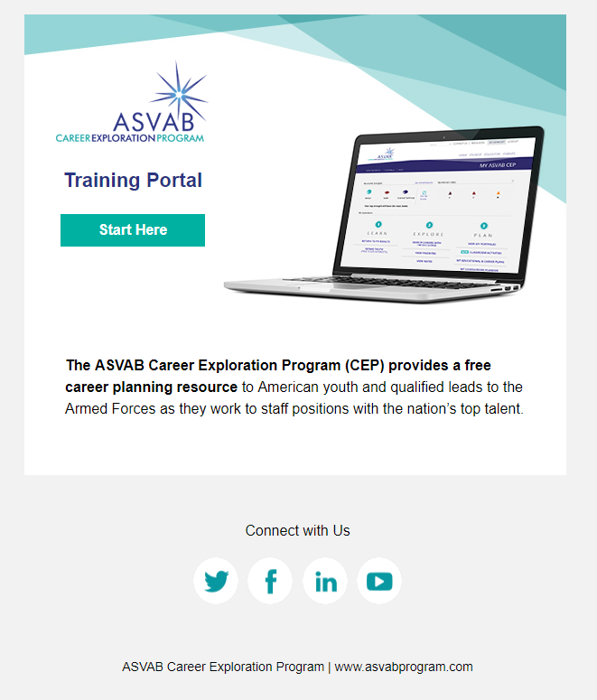
Virtual Training Consists of:
User authentication
Learning Objectives
Multimedia Content: including videos, print materials, social media, etc.
Concept Checks, Reflection and Application Activities
Area to upload supporting documentation
List of all people who are PTI proficient, regardless of job function or affiliation
Area to assign three-year access codes that are pre-populated with scores
Communication system for all people who are conducting PTIs across the US
Ability to collect information about training needs

Slide 35
Virtual Training Topics Covered
ASVAB Measurement, Data, and Use
ASVAB History and Validity
ASVAB Score Release Options for Schools
ASVAB Score Use Policies
Interpreting & Discussing ASVAB Scores
Basic Testing Theory & The ASVAB
Understanding the ASVAB Summary Results Sheet
Preparing Students to Work with the ASVAB Scores
Discussing Students’ ASVAB Scores
ASVAB CEP Components
The ASVAB CEP
The ASVAB
Find Your Interests
OCCU-Find and Career Planning Tools
Additional Resource – Careers in the Military
Conducting a Post Test Interpretation
Overview of Essential PTI Components
Online Post Test Interpretation
Interpreting ASVAB Results
Administering the FYI Online
Demonstrating the OCCU-Find
Demonstrating Careers in the Military
Additional Tools and Materials
Becoming PTI Proficient
How to Use the PTI Proficiency Evaluation Metric Lesson

Slide 36
In-Person Group Composition
Small Group
  Maximum 6
  Unrelated Facilitator
  Mixed experience and job function
Homework Group
  Maximum ?
  No one from small group
  Close geographic proximity

Slide 37
Attendee Feedback
“I do not, and likely will not conduct PTIs as a recruiter, but by now knowing this procedure exists, I will look to escort my MEPS TCs and ESSs for their PTIs.”
“The metrics are easy to follow and organized logically. They will make this process to nominate other personnel for the training to be simple.”
“As a recruiter, the content of this training is, without a doubt, completely game changing. It will allow me to access non-military friendly schools with ease and provide future generations with valuable tools."
"Having very little experience with the ASVAB, I found it easy to retain information and overcome the learning curve. This was because of well-prepared content and a thoughtful and engaging structure"
“A lot of information provided throughout the presentation and interaction with the variety of participants from different agencies and services.”
75%
93%
Theme
did not know much about the site until they participated in the online training.
were satisfied or very satisfied with the training.
Many participants were unaware of the nature and use of Career Exploration Scores and the training provided this framework for them.
Notes:
93% indicated that they were satisfied or very satisfied with the training.
majority of participants thought the small group structure was the best feature of the training and taught them the most about giving a PTI
Based on what they learned from the training in Monterey, respondents indicated that they will practice more, use the website more, and share information/train others/nominate others back in the field to improve their PTIs.

Slide 38
Expert Panel: FYI Revisions
Expert Panel Members: Jim Rounds, Patrick Rottinghaus,
Contract Project Manager: Rod McCloy,
Government: Dan Segall, Marry Pommerich, Shannon Salyer

Slide 39
Background
OPA convened an ASVAB CEP Expert Review in 2017 to comment on revisions to CEP and its measures, ASVAB and FYI
Review recommended thorough revision of the FYI
  Item revisions and additional items are required to assess a broader array of basic interests (e.g., information technology, leadership, health services)
    Most commercial interest inventories are evaluated/revised routinely, typically every 5 to 7 years
Review recommended an evaluation of the current FYI item pool to achieve an inventory that encompasses critical, occupationally relevant tasks for high school students and is culturally appropriate
Review recommended integrating basic interest scales into the CEP
  Research suggests that basic scales provide . . .
    a richer interpretation of interests than Holland types do (Day & Rounds, 1997; Gasser, Larson, & Borgen, 2007; Liao, Armstrong, & Rounds, 2008; Ralston, Borgen, Rottinghaus, & Donnay, 2004; Su et al., 2018)
    more transparent linkages between a person’s interests and the interests and activities associated with work environments

Slide 40
Background (cont.)
The review discussed the need to revise the FYI on a routine basis to ensure item content is relevant, and to consider incorporating advances in interest measurement (e.g., computerized adaptive testing)
  Process would involve several steps, including (a) a content analysis of the items to determine the extent to which the Holland types are covered and (b) exploration of potentially new content domains critical to both the current occupational landscape and overall relevance to the target population of students using the ASVAB CEP.
The review discussed the need for more precise measures of basic interest domains (e.g., science, mathematics, mechanical activities, healthcare, public speaking), which are analogous to those offered in the Strong Interest Inventory (SII; Donnay, Morris, Shaubhut, & Thompson, 2005) and could supplement the existing Holland measures (Day & Rounds, 1997; Ralston et al., 2004)
In addition to an expert review of the FYI items, existing data could be used to conduct an item analysis, including exploration of differential item functioning (DIF) and an investigation of the factor structure to inform the revision process.
Review members offered differing opinions on whether to change the Like-Indifferent-Dislike (LID) format in favor of a 5-point scale in future revisions
  Different scale options could be evaluated by focus groups, and data from pilot studies could inform decisions on selecting the best response scale for the revised FYI.

Slide 41
Tasks Conducted in Initial Research on FYI Revision
Obtain a representative sample of existing FYI data.
Conduct a preliminary expert review of existing FYI items. Prior to expert review, conduct descriptive item analyses (M, SD, and item response distributions) by sex and race. These data are to be used in item reviews.
Conduct a structural analysis of the RIASEC scales by gender using multidimensional scaling, randomization tests (Rounds, Tracey, & Hubert, 1992), and circular unidimensional scaling (Armstrong, Hubert, & Rounds, 2003).
Conduct a structural analysis of the RIASEC scales by race/ethnicity using multidimensional scaling, randomization tests (Rounds et al., 1992), and circular unidimensional scaling (Armstrong et al., 2003).
Conduct a content analysis of the current FYI RIASEC scales to identify facets (basic interests). Each RIASEC scale (15 items) will be analyzed according to the RIASEC basic interest RIASEC classification proposed by Su et al. (2018) to identify item coverage.
Recommend a set of new basic interest scales and other specialized scales (e.g., work styles) informed by the previous item content analyses and structural analyses of the FYI; identify potential new target domains suggested by the 2017 ASVAB CEP Panel Report (e.g., Information Technology, Leadership, Public Speaking, and others included in the U.S. Department of Education’s States’ Career Cluster Initiative [e.g., STEM, Health Sciences]).
Make final recommendations for further development of a Holland-based RIASEC measure.

Slide 42
Sample
Data were collected from a national sample of 384,391 students who completed the FYI as part of participating in the ASVAB CEP
  177,994 (46.3%) females
  206,397 (53.7%) males
  71,919 (18.7%) 10th-grade students
  232,216 (60.4%) 11th-grade students
  79,257 (20.6%) 12th-grade students
  864 (0.2%) post-graduate individuals
  193,897 (74.8%) White
  29,183 (11.3%) Hispanic
  18,880 (7.3%) African American,
  10,616 (4.1%) Asian/Pacific Islander,
  6,477 (2.5%) Native American (1.7%), and
  47,608 (12.4%) who identified as multi-ethnic
  77,730 (20.2%) participants did not report race/ethnicity.

Slide 43
Results by Sex
For both females and males, the RIASEC scales showed strong internal consistency
  Cronbach’s alpha= .90 to 94 (females), .90 to .95 (males)
Sex differences across the RIASEC scales
  Males scored higher than females on the Realistic (d = -0.98) and Investigative (d = -0.23) dimensions
  Females scored higher than males on the Social (d = 0.77) and Artistic (d = 0.38) scales.
  There were no significant gender differences on the Enterprising and Conventional scales.
Structural analyses
  Current FYI items poorly fit the RIASEC model for males
    A likely reason is that the item selection procedure that mirrored interrelations among the RIASEC types was not applied to a male sample
    A revision of the item pool should use the same procedures with males as was used with females to select items
    It is also important to include all racial-ethnic groups in the item selection process, including White students.

Slide 44
Next Steps
DPAC to review recommendations and discuss a way ahead for the update of the FYI.
Will keep MAPWG and DACMPT informed of these efforts.

Slide 45
#OptionReady

Slide 46
What is #optionready?
The ASVAB CEP can be used in various ways:
    Post-Secondary Options
    Career Options
    Score Release Options
    Scalable Implementation Options
Being #optionready is being informed about the options
Landing page: asvabprogram.com/option-ready
  Sharable content school counselors can easily use to inform their community about benefits of ASVAB CEP participation and encourage sign up
  Sharing portal for those who wish to upload photos and videos from PTI workshops to encourage peer-to-peer sharing

Slide 47

#optionready Campaign
Goal: Reach 1 million participants in the ASVAB CEP within one academic year
Purpose: Correct misconceptions to improve reputation. Build awareness of the benefits of participation to increase participation.
Metrics to Gauge Success:
Number of landing page visits
Number of toolkit downloads and content shares
Number of #optionready engagements on social
Number of photos and videos submitted via sharing portal
Increase in participation
Increase in bring it to your school requests

Slide 48
Shannon Salyer, Ph.D.
Shannon.d.salyer.civ@mail.mil

