Slide 1

ASVAB Career Exploration Program:
Initiatives and Modernization

Slide 2
Discussion Topics
Expert Panel Recommendations and Progress
Business Modernization Contract
State Usage and ESSA
PTI Proficiency Training
#OptionReady

Slide 3
Expert Panel Recommendations and Progress

Slide 4
Expert Panel/Needs Assessment: Program Processes
Develop electronic reminder system to maintain contact with students and parents between testing and interpretation.
Develop a mechanism for including parents in the career exploration process.
Develop a protocol for sending personalized reminders of available resources and activities that can further engage the students in reflecting on their assessment results and career/educational exploration plans.
Session numbers and other manual processes hindering effectiveness of program (Needs Assessment Finding)
  Business Modernization Contract
    Includes a look at manual processes that occur throughout the lifecycle of the CEP, from scheduling to accountability. Includes requirements gathering to update legacy systems. Joint project with USMEPCOM. June 2019-2020

Slide 5
Expert Panel/Needs Assessment: Assessments
Expert panel recommended a review/evaluation of the current FYI item pool to achieve an inventory that encompasses critical, occupationally relevant tasks for high school students and is culturally appropriate
  FYI Revision Efforts
    Presentation by Olga Friedman to follow on current state of FYI. Future efforts will commence September 2019-2021

Slide 6
Expert Panel/Needs Assessment: Websites
Under Resources, some are .pdf files and some are Word documents. The panel recommends converting all resources into writeable .pdf files. The website also should provide a link to Adobe for those who might not have downloaded the software to read pdfs.
The Resources section also contains links to items that are not relevant to students (i.e., ASVAB CEP Counselor Guide). The panel recommends that the website is configured such that the available resources are specific to each user population (students, educators, parents).
  Reconfigured and implemented a new resource center on asvabprogram.com, includes integration of twitter feed and other social media.
  Website reconfiguration planned with website refresh (2021-2022)

Slide 7
Expert Panel/Needs Assessment: Inclusion in Scientific Literature
The ASVAB CEP and the FYI should be marketed to professional journals and textbooks, as well as integrated into the National Certified Counselors curriculum.
  ASVAB CEP included in: A comprehensive Guide to Career Assessment, 7th Edition, Published by NCDA
  https://www.ncda.org/aws/NCDA/pt/sd/product/11018/_PARENT/layout_products/false
Part IV – Career Assessment Instrument Reviews
Ability Explorer – Kathy M. Evans (Both Print and Online)
Ashland Interest Inventory – Darrin L. Carr, Pamela McCoy, & Alyssa West
ASVAB – Laith G. Mazahreh
California Psychological Inventory – Rebekah Reysen
Career Decision Self- Efficacy Scale – Joshua C. Watson (Both Print and Online)
Career Occupational Preferences System Interest Inventory (COPS) – Jenna Crabb
Career Thoughts Inventory – Brian M. Calhoun
Jackson Career Explorer – Justin R. Fields
Jackson Vocational Interest Inventory – Julie Aitken Schermer
Kuder Career Planning System – Melinda M. Gibbons & Charmayne R. Adams (Both Print and Online)
NEO-4 – Brian J. Taber
Occupational Aptitude Survey and Interest Schedule (OASIS-3) – Amanda G. Flora
Self- Directed Search – Chad Luke & Zach Budesa
Work Values Inventory – S. Autumn Collins
Career Construction Interview – Louis A. Busacca (Both Print and Online)
Career Genogram – Tina M. Anctil
Knowdell Card Sorts – Tanya M. Campos

Slide 8
Expert Panel/Needs Assessment: Reports and Interpretation
Post Test Interpretations, inconsistencies, lack of website usage (Needs Assessment)
Identify strategies to increase engagement with the CEP to increase the amount of time spent exploring occupational information and other resources to strengthen the depth of processing and personal relevance. For example, involve more interactive online activities, and link to the portfolio within the CITM with internet resources and activities that supplement guided exploration with counselors and parents.
  PTI Training Effort
    Detailed information on the virtual and in-person training to follow. February 2019-August 2019 (As needed)

Slide 9
Expert Panel/Needs Assessment: Website Engagement
Identify strategies to increase engagement with the CEP to increase the amount of time spent exploring occupational information and other resources to strengthen the depth of processing and personal relevance.
Conduct a thorough review of training provided to Education Services Specialists and of post-test interpretation processes, to include updates to the websites, measures, and activities.
Expand the interpretative information for ASVAB results to provide detailed suggestions for understanding and strengthening skills. Consider including additional reflective questions to enhance understanding of results and facilitate action steps for the career exploration process.
Make it a priority to increase the number of computerized administration options beyond the current CEP, including smartphone applications.
  Classroom activity inclusion and PTI Training
    By educating the field on the information included in the websites, and inviting recruiting commands to participate in the train-the-trainer model, we have built in multiple opportunities for schools, counselors, and recruiters to use the CEP to inform students of their options. (Ongoing)

Slide 10
Expert Panel/Needs Assessment: Recommendations and Progress
Other Comments, Suggestions, Ideas for the Program:
Develop a work values measure that links an individual’s work values to occupations
  Under contract September 2019-2020
Develop a Successful Job Search toolbox on the asvabprogram.com website that includes how to develop a resume, use social media, search for a job, and interview for a job
  Under contract June 2020
Provide uniform credentialed career development training to ASVAB CEP administrators and interpreters
  USMEPCOM investigating funding options and feasibility of incorporation in the CP-31 Program.
  Investigating offering CEUs for pre-conference workshops

Slide 11
Business Modernization Contract

Slide 12
Business Modernization Contract
  Conduct a gap analysis of the existing business practices and technology associated with the ASVAB CEP, to include testing inventory software (Wintip), business administration software (Schools 2001), session number assignment, Ubis, and other applications or programs associated with the administration, customer relationships, marketing, and communication or operational practices. The gap analysis should also provide input into what is currently working well in the field, user interface preferences, inconsistency of data, etc.
    Kickoff with USMEPCOM May 2019, identified sites, priorities, etc.
    Site visits being planned for: Dallas, Maryland, San Angelo, Sacramento, San Jose, Anchorage, Honolulu/Palau, San Juan, Fort Lee, Miami
    Site visits include Pre-visit phone call, Overview of WinTip and uses and Schools, speaking with personnel on processes and capabilities most used/needed. Most site visits range from 1-4 days.

Slide 13
Business Modernization Contract
    Provide a report on current software and recommended software (Off-the-shelf, in-house modified, applications, etc) that would allow USMEPCOM, AP, and OPA to replace legacy systems, and automate processes associated with the Student testing program.
      This report should outline each functionality that could be updated or modernized, and for all options, outline: capabilities, costs, maintenance costs, processes automated, ability to integrate with MIRS or other existing databases, servers or ancillary hardware/software requirements, timelines to implement, user friendliness of software, ease of administration, and reporting abilities.
      These findings shall be presented to AP, USMEPCOM, and OPA at an IPR. (IPR tentatively planned for May/June 2020, location TBD)
FUTURE TASKS (Will require additional funds)
    Depending on the recommendations from the IPR, purchase, set up and/or implement the necessary applications, servers, hardware, etc. for each of the business processes to update.
    OPA POCs: Doug Keindl, Shannon Salyer USMEPCOM POCs: Jaime Clayton, David Davis

Slide 14
State Usage and ESSA

Slide 15
State Legislature Schedules for 2020
http://www.statescape.com/resources/legislative/session-schedules
http://www.ncsl.org/research/about-state-legislatures/2019-state-legislative-session-calendar.aspx (Another useful site (but current schedules only)
https://inspire2serve.gov/NCOS%20Interim%20Report.pdf
  The National Commission on Military, National, and Public Service is a bipartisan, 11-member Commission created by Congress to develop recommendations to inspire more Americans—specifically young people—to participate in military, national, and public service and to review the military selective service process.
  The Commission was established on September 19, 2017 and launched in January 2018. They released an Interim Report on January 23, 2019. Addressed to the American public, Congress, and the President, the Interim Report outlines issues we are exploring and summarizes our work to date. We will publish our Final Report, complete with policy recommendations and legislative proposals, by March 2020. Our work will conclude by September 2020.
  Specific recommendations about expanding the ASVAB CEP Nationally

Slide 16
Contracting Effort: State Usage of ASVAB
Monitoring websites
  State Boards and Departments of Education
Goal: Glean any mention of their use of ASVAB or ASVAB CEP
Method
  Excel file with links to each state’s Board or Department of Education news/press release website, dummy variable tracking if state websites offer any information on ASVAB CEP
  Websites checked weekly for any updates/changes
  Offer notes on ESSA and other career exploration information from the state

Slide 17
States that reference ASVAB CEP or career development in legislation
Indiana
Kentucky
Michigan
Minnesota
North Dakota
New Jersey
Virginia
West Virginia
Wyoming
Indiana, Minnesota, New Jersey, North Dakota, and West Virginia, mention ASVAB CEP as a career exploration tool
Pending legislation in Kentucky will require ASVAB testing with follow-up counseling in high schools
ASVAB CEP endorsed online by Superintendent of Education in Wyoming

Slide 18
States that mention ASVAB only in legislation
Alaska
Colorado
Maryland
Missouri
Mississippi
New Hampshire
New Mexico
Nevada
New York
Oregon
South Carolina
Tennessee
Texas
Vermont
Alaska, Colorado, Maryland, Mississippi, Missouri, Nevada, New Hampshire, New Mexico, and Vermont indicate use of ASVAB as one indicator of college and career readiness
Michigan lists ASVAB as a "suggested strategy" to meet Target 2 (Contextualized Academics) in the Michigan Career Development Model
New York gives option of offering ASVAB as a school choice, and Oregon provides links to ASVAB websites for more information
South Carolina ESSA Plan indicates use of ASVAB AFQT score as an indicator of military readiness
Legislation passed in Texas will allow students to use ASVAB as vocational test
Notes:
Due to the ambiguity of the information we were able to find on the web, it’s unclear whether some states are referring to just the ASVAB or the CEP as well (and just not referring to it).

Slide 19
Option to Meet Graduation Requirement | Military and Career Readiness Indicator | Required/ Recommended for Career Exploration | Legislation Activity | Mentions ASVAB CEP on State Website | Limited or Specialized Use
Alaska | Alabama | California | Iowa | Nebraska | Connecticut
Colorado | Arkansas | Indiana | Kentucky | New Jersey | Florida
Indiana | Arizona | Iowa | Maryland | Oregon | Georgia
Mississippi | Delaware | Minnesota | Minnesota | Washington, DC | Hawaii
New Jersey | Iowa | North Dakota | New Hampshire |  | Idaho
New Mexico | Indiana | South Carolina | Pennsylvania |  | Illinois
Nevada | Kentucky | Texas | Texas |  | Kansas
Pennsylvania | Maryland | Virginia | Virginia |  | Louisiana
Tennessee | Minnesota | West Virginia |  |  | Massachusetts
Texas | Mississippi | Wyoming |  |  | Maine
Washington | Montana |  |  |  | Michigan
 | North Dakota |  |  |  | Missouri
 | New Hampshire |  |  |  | North Carolina
 | New Mexico |  |  |  | New York
 | Nevada |  |  |  | Ohio
 | Rhode Island |  |  |  | Oklahoma
 | South Carolina |  |  |  | Rhode Island
 | Virginia |  |  |  | South Dakota
 | Vermont |  |  |  | Utah
 | Wyoming |  |  |  | Wisconsin

Slide 20
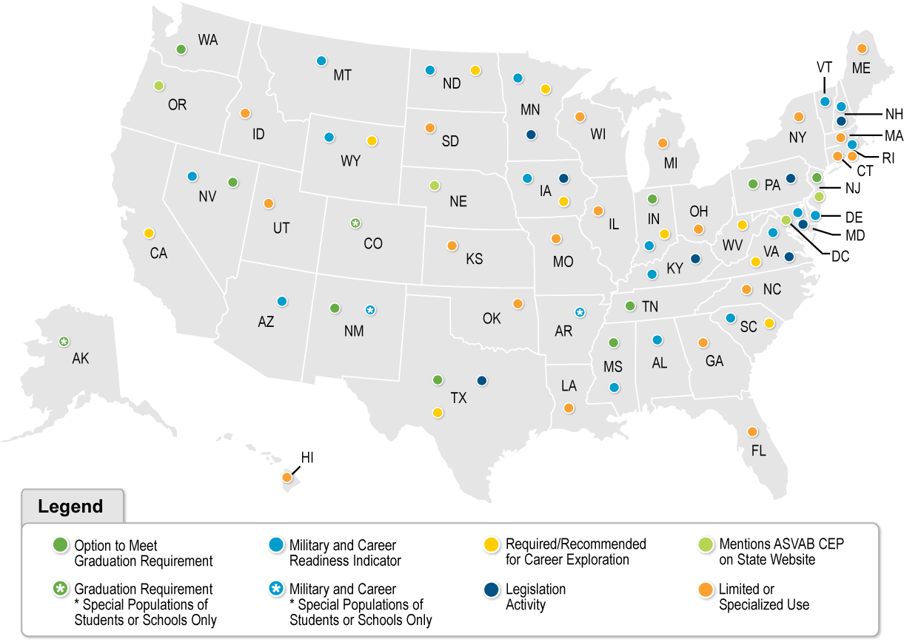
Level of Engagement by State

Slide 21
ASVAB CEP and ESSA
Several States have passed legislation requiring schools to provide ASVAB CEP to high school students, however, legislation is not worded accurately. Some States do not understand the difference between CEP and ETP (random students with no intention of enlisting showing up to MEPS to meet graduation requirement, no testing on weekends, increased number of FOIAs etc.)
Military Services have been speaking to legislators about the ASVAB CEP and the benefits of the program. But many of them are not aware of the program updates or consider the resource implications of this type of program expansion. Also making assertions about data that the DoD is not able to fulfill.
Stakeholder meeting held August 15, 2019 in Alexandria, VA which included participants from AP, USMEPCOM, Military Service Liaisons, and members from the Defense State Liaison Office. Discussion around importance of educating field and coordinating efforts.
Agenda: Review of States and how they use ASVAB CEP, Service initiatives, review of legislative calendar, AP guidance, data and processes for obtaining data, social media and tool kits
    Subsequent meeting with all representatives from DSLO to ensure correct understanding and wording is considered when discussing legislation and ASVAB CEP.

Slide 22
Impact of TX Legislation on testing numbers and options chosen by schools
MEPS SY 16-17 | 1 | 2 | 3 | 4 | 5 | 6 | 7 | 8
Amarillo | 2,046 | 644 | 269 | 61 | 173 | 678 | 11 | 1,166
Dallas | 7,977 | 1,923 | 675 | 77 | 572 | 1,459 | 122 | 5,747
El Paso | 2,381 | 5 | 0 | 28 | 1089 | 288 | 16 | 1,498
Houston | 6,800 | 2,384 | 993 | 220 | 1259 | 604 | 316 | 4,165
San Antonio | 8,202 | 1,495 | 160 | 0 | 472 | 951 | 107 | 3,620
9th BN | 27,406 | 6,451 | 2,097 | 386 | 3565 | 3,980 | 572 | 16,196
MEPS SY 17-18 | 1 | 2 | 3 | 4 | 5 | 6 | 7 | 8
Amarillo | 1,858 | 520 | 297 | 125 | 48 | 810 | 18 | 1,401
Dallas | 9,385 | 1,538 | 256 | 273 | 2295 | 1,319 | 168 | 8,523
El Paso | 2,759 | 26 | 850 | 23 | 853 | 173 | 42 | 2,179
Houston | 5,659 | 1,268 | 991 | 216 | 1762 | 1,109 | 331 | 6,123
San Antonio | 7,686 | 2,104 | 102 | 0 | 193 | 1,261 | 602 | 4,229
9th BN | 27,347 | 5,456 | 2,496 | 637 | 5151 | 4,672 | 1,161 | 22,455
Does Not Include 10th Grade Students: 60,653
Does Not Include 10th Grade Students: 69,375
**School year runs from July 1- June 30. Final numbers (as of June 30, 2018).

Slide 23
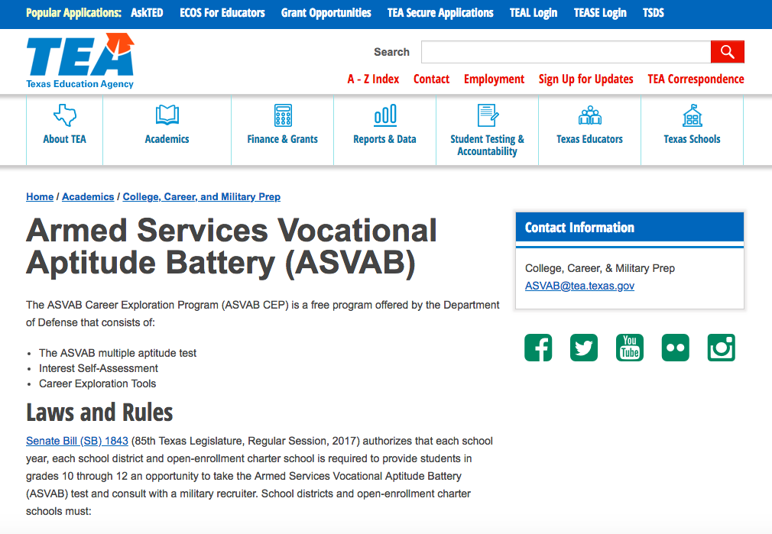
ASVAB CEP and Texas
Conducted State-wide Video Conference for Superintendents, Principals, Counselors, and Teachers
Worked with TX DOE to create webpage dedicated to ASVAB CEP hosted on State website with FAQs updated as needed.
Austin Chamber of Commerce involved in career exploration process and visiting schools to teach teachers about portfolio resource, and, for students who opt in, sending texts about the importance of military service.

Slide 24


ASVAB CEP Orientation Event in Indiana
ASVAB CEP is included as a Pathway to Graduation in Indiana
  IDOE hosted a three-hour overview of program components
  125 attendees
    Most were previously unaware of the website offerings
    70% of attendees said they will utilize the PTI in the future
  Opportunity for follow up webinar series
    Three additional webinars discussed, the first will be given in November. The webinars will be posted on Indiana DOE website and advertised through social media.

Slide 25
ESS and Recruiting Commands Engagement with State BOEs
Supplied a memo to the field regarding the appropriate uses of the ASVAB CEP (Approved by AP)
Included guidance during State presentations, Q/A sessions, National Conferences on appropriate uses of ASVAB CEP
Will continue to monitor State legislation and utilization of ASVAB CEP, we will communicate efforts from this contract to USMEPCOM and Sector ESS.
Please encourage ESS to communicate any information about State legislative activities to Sector ESS. Sector ESS will inform HQ ESS and OPA so we can begin coordinating national efforts to assist.

Slide 26
PTI Proficiency Training

Slide 27
PTI Proficiency Training
Because:
We have more States looking at the ASVAB CEP as a program to give for career exploration, we have an increased pressure to visit schools more than once (additional work load), and deliver a standard program. (Needs Assessment, Expert Panel Recommendation)
Because we have added new functionality to asvabprogram.com and careersinthemilitary.com, MEPS ESSs (as a whole) have not been adequately trained to use the websites effectively or to train others to use them. (Needs Assessment, Expert Panel Recommendation)
We have not had a way to track our national work force for ASVAB CEP in delivering PTIs. With the introduction of virtual training, a standard metric, and training, we can now establish this. (DAC Recommendation)
This training will be a stepping stone to the Certified Career Counselor Credential offered by the National Career Development Association. (Needs Assessment, Expert Panel Recommendation, DAC Recommendation)
The standard metric of required elements, with behavioral anchors, removes most subjectivity of the training process, and allows us to use it as a learning and evaluation tool. (Expert Panel Recommendation)

Slide 28
ASVAB CEP Numbers and Metrics
Year* | Number of Students Tested
2013 | 670,836
2014 | 690,950
2015 | 687,900
2016 | 706,200
2017 | 684,223
2018 | 713,777
2019 | 786,807
Year* | Number of Schools Tested | Percentage of Schools Tested
2013 | 12,613 | 56%
2014 | 12,731 | 56.4%
2015 | 12,929 | 56.6%
2016 | 13,169 | 57.2%
2017 | 12,870 | 55.5%
2018 | 12,380 | 55%
2019 | 13,976 | 60.6%
*School year runs from July 1- June 30. Data as of 30 June of respective year.
Notes:
Indianapolis increased the number of students tested by 405 percent more than last year's goal which increased percentage of leads by 386 percent largely due to state legislation.
786, 807 students test is the most students tested in over 20 years. Probably longer.

Slide 29
Website Utilization: www.asvabprogram.com
(July 1 – June 30)
 | 17-18 | 18-19
Unique Visitors | 440,882 | 582,162
Returning Visitors | 203,357 | 225,100
Page Views | 6,747,160 | 8,550,582
Bounce Rate | 31.41% | 28.18%
Average Time Per Session | 12:55 | 11:43
Number of Pages Per Session | 10.49 | 10.10
Tablet/Mobile Visitors | 212,870 | 332,850

Slide 30
Access Code Utilization
(July 1, 2018 – June 30, 2019)
Code Type | Visitors | Repeat Visitors
Marketing | 2,068 | 925
Counselor | 2,022 | 1,014
Student | 246,895 | 99,452
Reserve | 719 | 340
Total Number of Logins | 251,704 | 101,731
The number of student access codes used indicates a heavy reliance on the paper based booklets, schools not requesting a post test interpretation, resource limitations for a second visit, or a failure to educate the schools about the PTI option.
Notes:
30%

Slide 31

PTI Proficiency Requirements
Be Nominated to become proficient
Complete virtual training modules
Be observed effectively conducting a PTI
Load proof of proficiency into Moodle

Slide 32
Post-Test Interpretation Proficiency Training
In-Person PTI Training
Participation
USMEPCOM | 128
Army | 72
Navy | 15
Air Force | 7
Coast Guard | 9
Goal: Standardize the process by which post-test interpretation (PTI) sessions are conducted. Serve as a workforce multiplier (using a train the trainer approach) by including Recruiting Service Partners to satisfy demand for program in schools.
Purpose: Address expert panel recommendations to orient attendees to the ASVAB CEP enhancements, and teach attendees the strategic purposes of collaborating with others operating within their territory to achieve missions.
Metrics to Gauge Success: Increased utilization of ASVAB CEP related websites, increased testing numbers, virtual training use, in-person training attendance, additional access opportunities for recruiters.
Total:
231
1,487
922
304
Total User Accounts
(Virtual Accounts Created)
Total Nominees Since Training
Total Workforce Strength
Steps to Become PTI Proficient
Step 1: Virtual Training
Step 2: In-person training
Step 3: Nominate, Observe, Evaluate others
Next Session
None Scheduled
(Those trained at OPA/MEPCOM formal in-person training sessions can train and evaluate others)

Slide 33
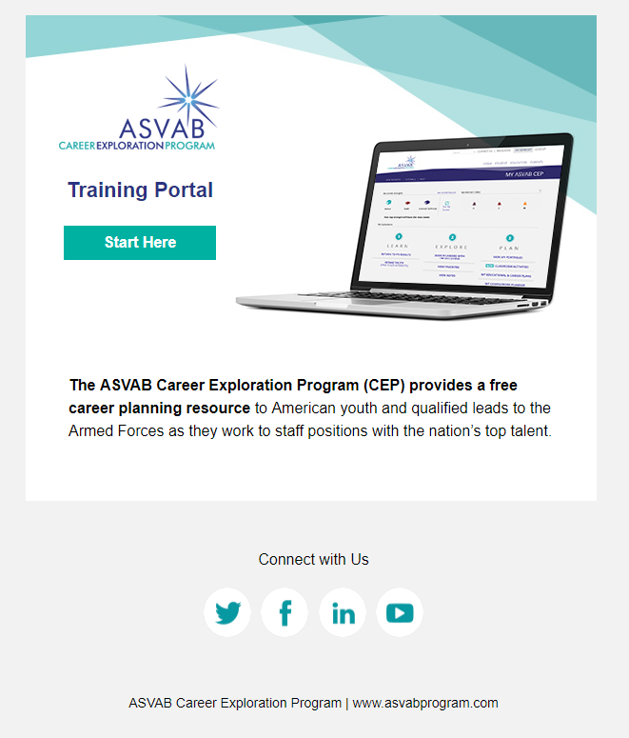
Virtual Training Consists of:
User authentication
Learning Objectives
Multimedia Content: including videos, print materials, social media, etc.
Concept Checks, Reflection and Application Activities
Area to upload supporting documentation
List of all people who are PTI proficient, regardless of job function or affiliation
Area to assign three-year access codes that are pre-populated with scores
Communication system for all people who are conducting PTIs across the US
Ability to collect information about training needs

Slide 34
Virtual Training Topics Covered
ASVAB Measurement, Data, and Use
ASVAB History and Validity
ASVAB Score Release Options for Schools
ASVAB Score Use Policies
Interpreting & Discussing ASVAB Scores
Basic Testing Theory & The ASVAB
Understanding the ASVAB Summary Results Sheet
Preparing Students to Work with the ASVAB Scores
Discussing Students’ ASVAB Scores
ASVAB CEP Components
The ASVAB CEP
The ASVAB
Find Your Interests
OCCU-Find and Career Planning Tools
Additional Resource – Careers in the Military
Conducting a Post Test Interpretation
Overview of Essential PTI Components
Online Post Test Interpretation
Interpreting ASVAB Results
Administering the FYI Online
Demonstrating the OCCU-Find
Demonstrating Careers in the Military
Additional Tools and Materials
Becoming PTI Proficient
How to Use the PTI Proficiency Evaluation Metric Lesson

Slide 35
In-Person Group Composition
Small Group
  Maximum 6
  Unrelated Facilitator
  Mixed experience and job function
  Mix of geographic locations
  No supervisor/supervisees in the same group
Homework Group
  Maximum 8
  No one from small group
  Close geographic proximity
  Mix of job functions
  Homework assignments were centered around topics that required discussion and collaboration (website analytics, ethical case studies)

Slide 36
Attendee Feedback
“I do not, and likely will not conduct PTIs as a recruiter, but by now knowing this procedure exists, I will look to escort my MEPS TCs and ESSs for their PTIs.”
“The metrics are easy to follow and organized logically. They will make this process to nominate other personnel for the training to be simple.”
“As a recruiter, the content of this training is, without a doubt, completely game changing. It will allow me to access non-military friendly schools with ease and provide future generations with valuable tools."
"Having very little experience with the ASVAB, I found it easy to retain information and overcome the learning curve. This was because of well-prepared content and a thoughtful and engaging structure"
“A lot of information provided throughout the presentation and interaction with the variety of participants from different agencies and services.”
75%
93%
Theme
did not know much about the site until they participated in the online training.
were satisfied or very satisfied with the training.
Many participants were unaware of the nature and use of Career Exploration Scores and the training provided this framework for them.
Notes:
93% indicated that they were satisfied or very satisfied with the training.
majority of participants thought the small group structure was the best feature of the training and taught them the most about giving a PTI
Based on what they learned from the training in Monterey, respondents indicated that they will practice more, use the website more, and share information/train others/nominate others back in the field to improve their PTIs.

Slide 37
Monitoring Effectiveness and use of PTI Proficiency Process
PTI Codes are monitored for frequency of use.
Each ESS receives a monthly reports on website analytics ( website traffic, number of student access codes used, time on websites, bounce rate, etc). These reports are intended to inform marketing plans and can be shared during the IRCs as needed.
Recruiters or unauthorized personnel using an access code intended for counselors or teachers will be deleted from website access and informed by email.
We will have another in-person training session this year, dates TBD

Slide 38
#OptionReady

Slide 39
What is #optionready?
The ASVAB CEP can be used in various ways:
    Post-Secondary Options
    Career Options
    Score Release Options
    Scalable Implementation Options
Being #optionready is being informed about the options
Landing page: asvabprogram.com/option-ready
  Sharable content school counselors can easily use to inform their community about benefits of ASVAB CEP participation and encourage sign up
  Sharing portal for those who wish to upload photos and videos from PTI workshops to encourage peer-to-peer sharing

Slide 40

#optionready Campaign
Goal: Reach 1 million participants in the ASVAB CEP within one academic year
Purpose: Correct misconceptions to improve reputation. Build awareness of the benefits of participation to increase participation.
Metrics to Gauge Success:
Number of landing page visits
Number of toolkit downloads and content shares
Number of #optionready engagements on social
Number of photos and videos submitted via sharing portal
Increase in participation
Increase in bring it to your school requests

Slide 41


Monthly Toolkit
Two-part Goal:
Make it simple to engage with ASVAB CEP on social media
Increase student participation
#whatsyourdreamjob
#optionready
Key Messages
Sample Posts
Links to all channels
Notes:
Counselor feedback suggests that students are often hesitant to sign up because of their preconceived belief that it’s just for those interested in the military. Counselors don’t know how to market the program.
The first 3 pages of this toolkit provide general info, tips and examples. Last page is updated monthly with new posts to share.
This gives school counselors and educators a simple way to share ASVAB CEP content and resources. Posts are pre-drafted for them. They only have to copy and paste. Plans to include additional graphics they can use to share on social media announcing Test Day.
ESS’s can also post to Facebook groups (I will post to national pages)
Monthly Toolkits are sent to Dave Serra for distribution to ESS’s.

Slide 42
National Events
Marketing Events (2018-2019) | Education/Research Industry | Stakeholder Engagement
American Counseling Association, March 28-30 Booth: 277 Leads National Career Development Association, June 26-30; Booth: 32 Leads National Charter Schools Conference, June 29-July 1; Booth: 265 Leads American School Counselors Association, June 30-July 3; Booth: 525 Leads National Principals Conference, July 17-21 Booth: 47 Leads National Career Pathways Network, October 12-13 Booth & Presentation Upcoming Event Association for Career and Technical Education, Dec 4-7 Booth, Exhibitor Presentation, Two Panel Presentations | IHIET, Aug 24 Presentation: Enhancing the Military Civilian Crosswalk | PTI Proficiency Training February-March, August Arizona DOE, April 2019 Georgia ACTE, JROTC July 2019 JAMINAR, July US Army National Educator Tour, May Indiana DOE, Sept 12, 2019

Slide 43



Communication Efforts: Program Materials

Slide 44
Inquiries
National Program Director
Shannon.d.salyer.civ@mail.mil
Sign Up to Receive Social Media Toolkit
kelly@writtenllc.com
Like, Follow, Share @asvabcep
#asvabcep | #youdecide | #optionready

